Slide 1

Vehicle Rental Management System
Project Number 17

Slide 2
Project mates
190031455
190031377
190031466

Slide 3
CONTENTS
Abstract
Modules
Module wise description
Use case diagram
Testing approach
Conclusion

Slide 4
What is Vehicle Rental Management system
Abstract

Slide 5
What is Vehicle Rental Management system?
Vehicle Rental Management System helps in automating all the services like booking, finding the car, collecting the car, returning, accounting, and vehicle management. Car rental companies run by purchasing or leasing several fleet vehicles and renting them to their purchasers for a fee.

Slide 6
How does Vehicle Rental Management system works?
Abstract

Slide 7
How does Vehicle Rental Management system works?
An online car rental system would connect drivers who rent vehicles to clients who want a vehicle.
Using a variety of filters, customers can find the right vehicle, a chat system would connect hosts directly to customers, and digital payment options would allow secure payment via the site

Slide 8
What is in this system?
Modules

Slide 9
What is in this system?
The project includes a tracker which will track the start time, end time, activity status, project status of a particular employee.
In this employee tracking system, we included two modules
Admin
Customer

Slide 10

Admin Module
The admin will be able to
Log in to the website.
Register customers, edit customer details.
Add, edit, remove customers in a project.
Edit the deadlines, agenda of the project.
Track the activity of customers and statistics of the project they are working on.

Slide 11

Customer Module
The Customer will be able to :
Log in to the website
Enter the start time/end time of their shift
View the project details
View their project and project teammates
View their status in the project

Slide 12
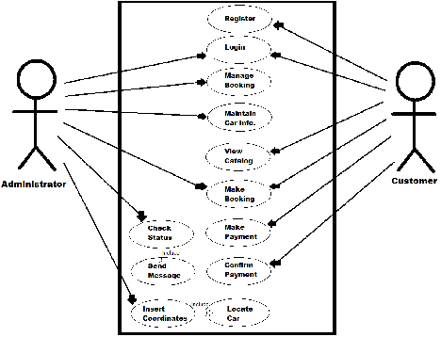
Use Case Diagram

Slide 13
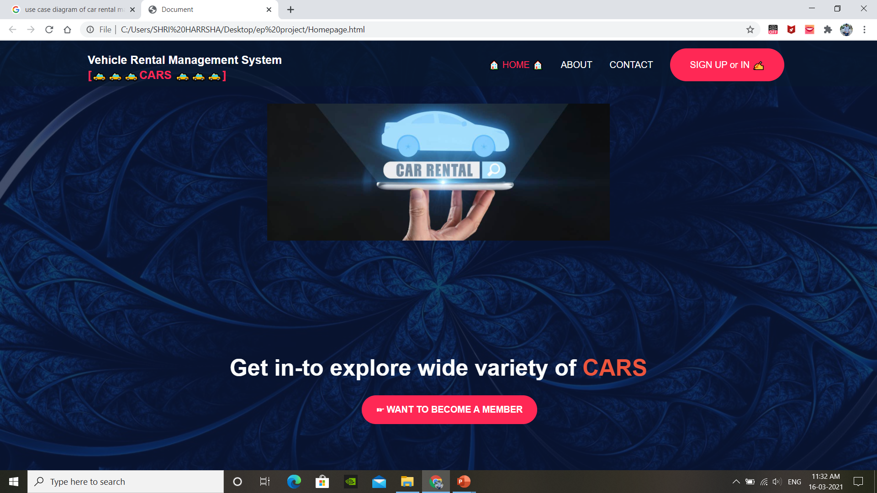
Testing approach

Slide 14
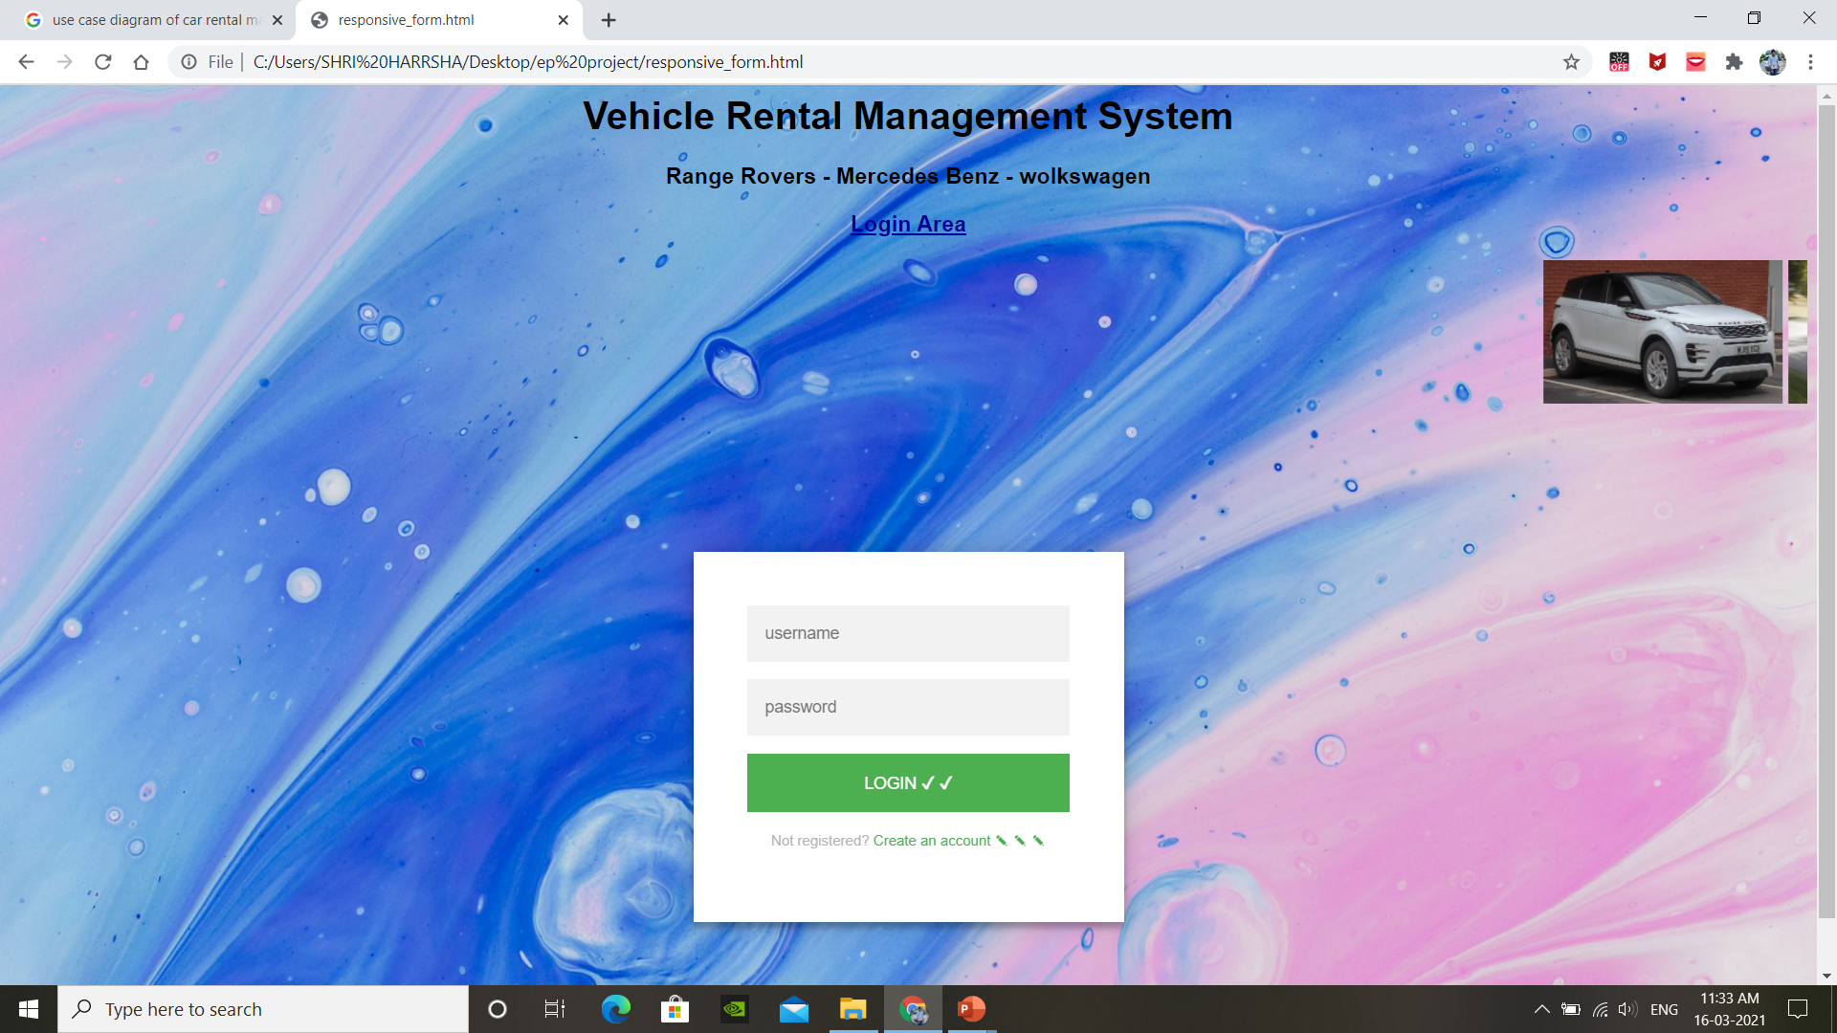

Slide 15
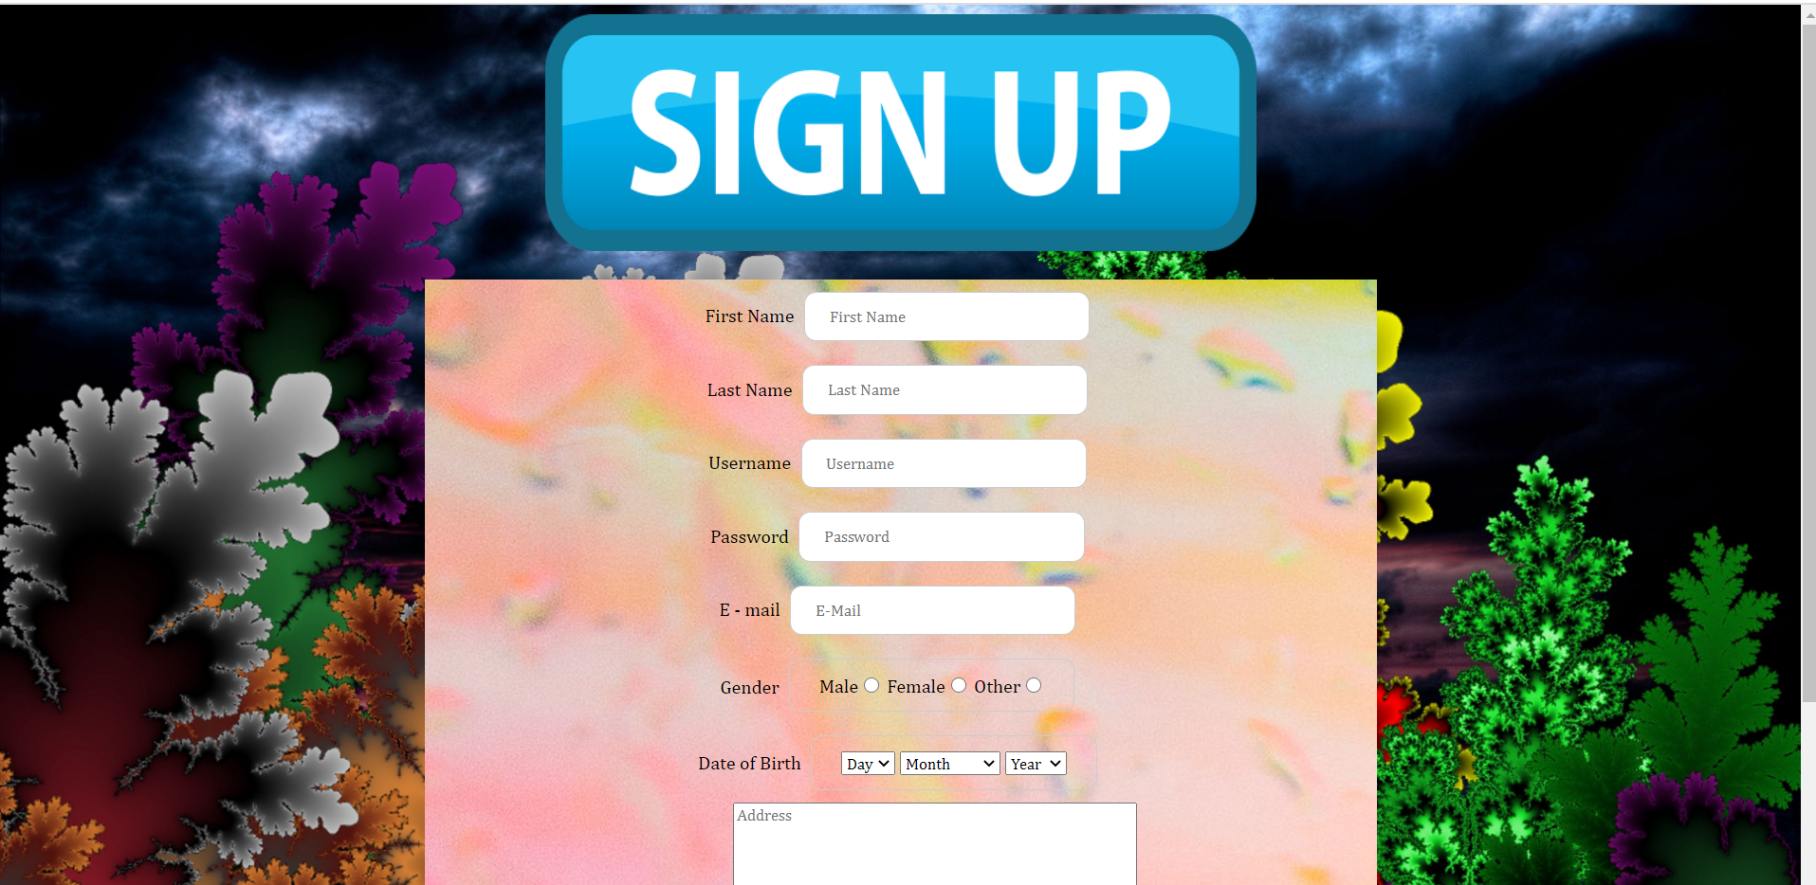

Slide 16
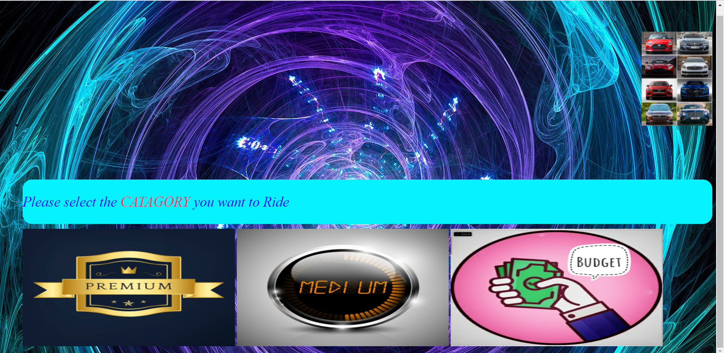

Slide 17
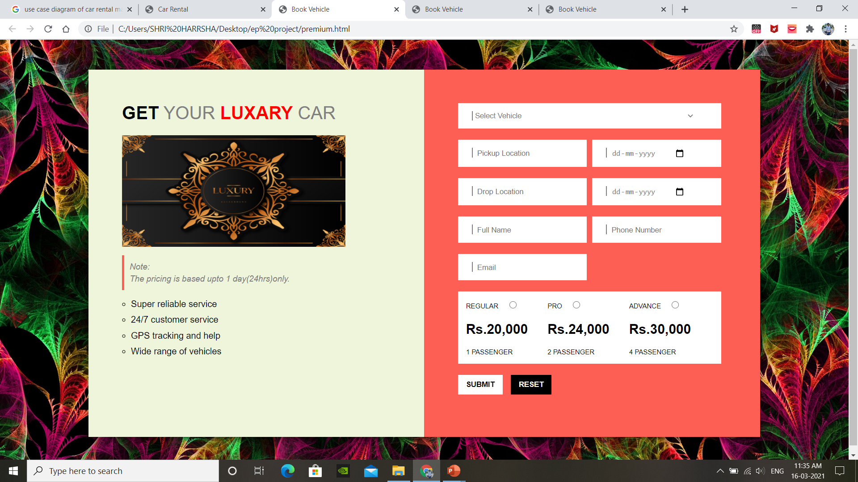
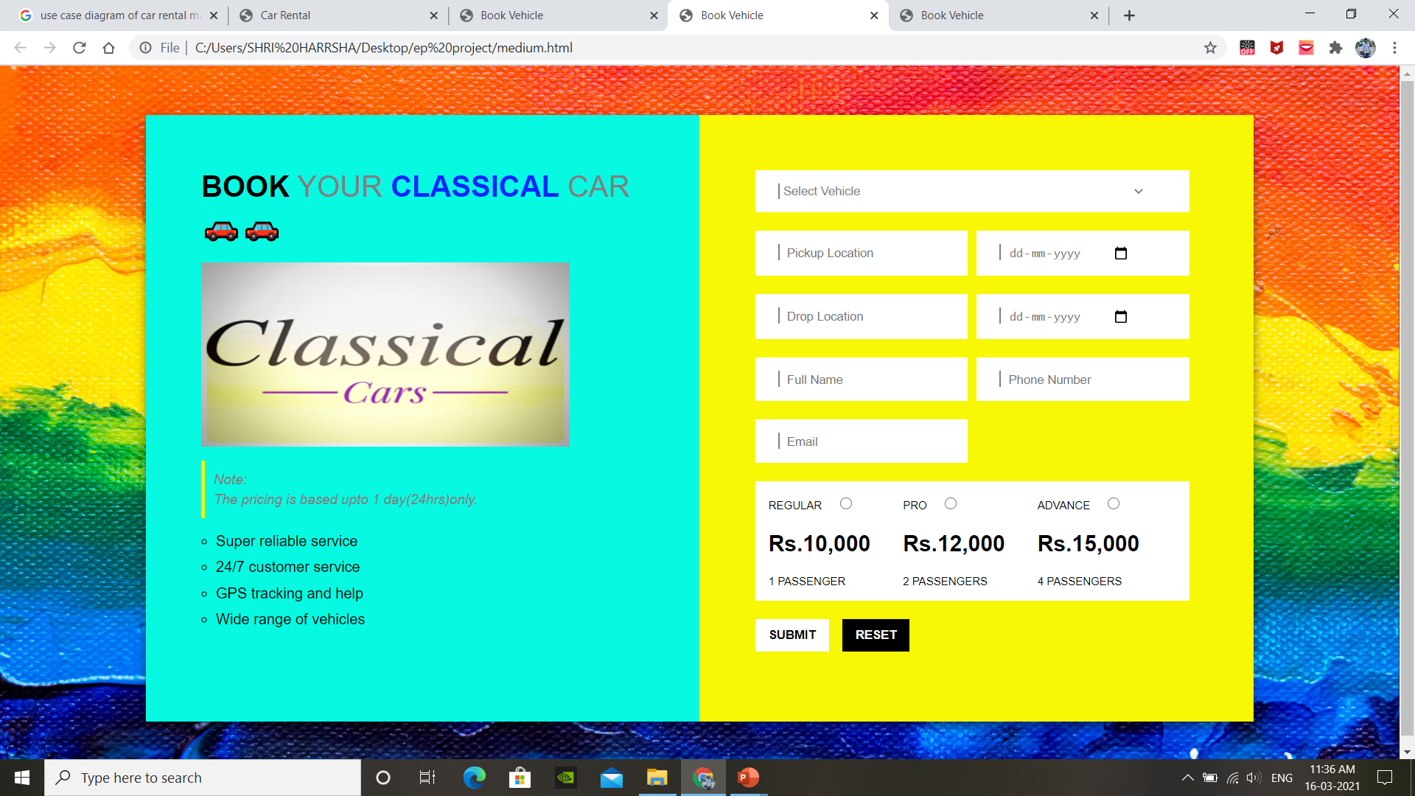
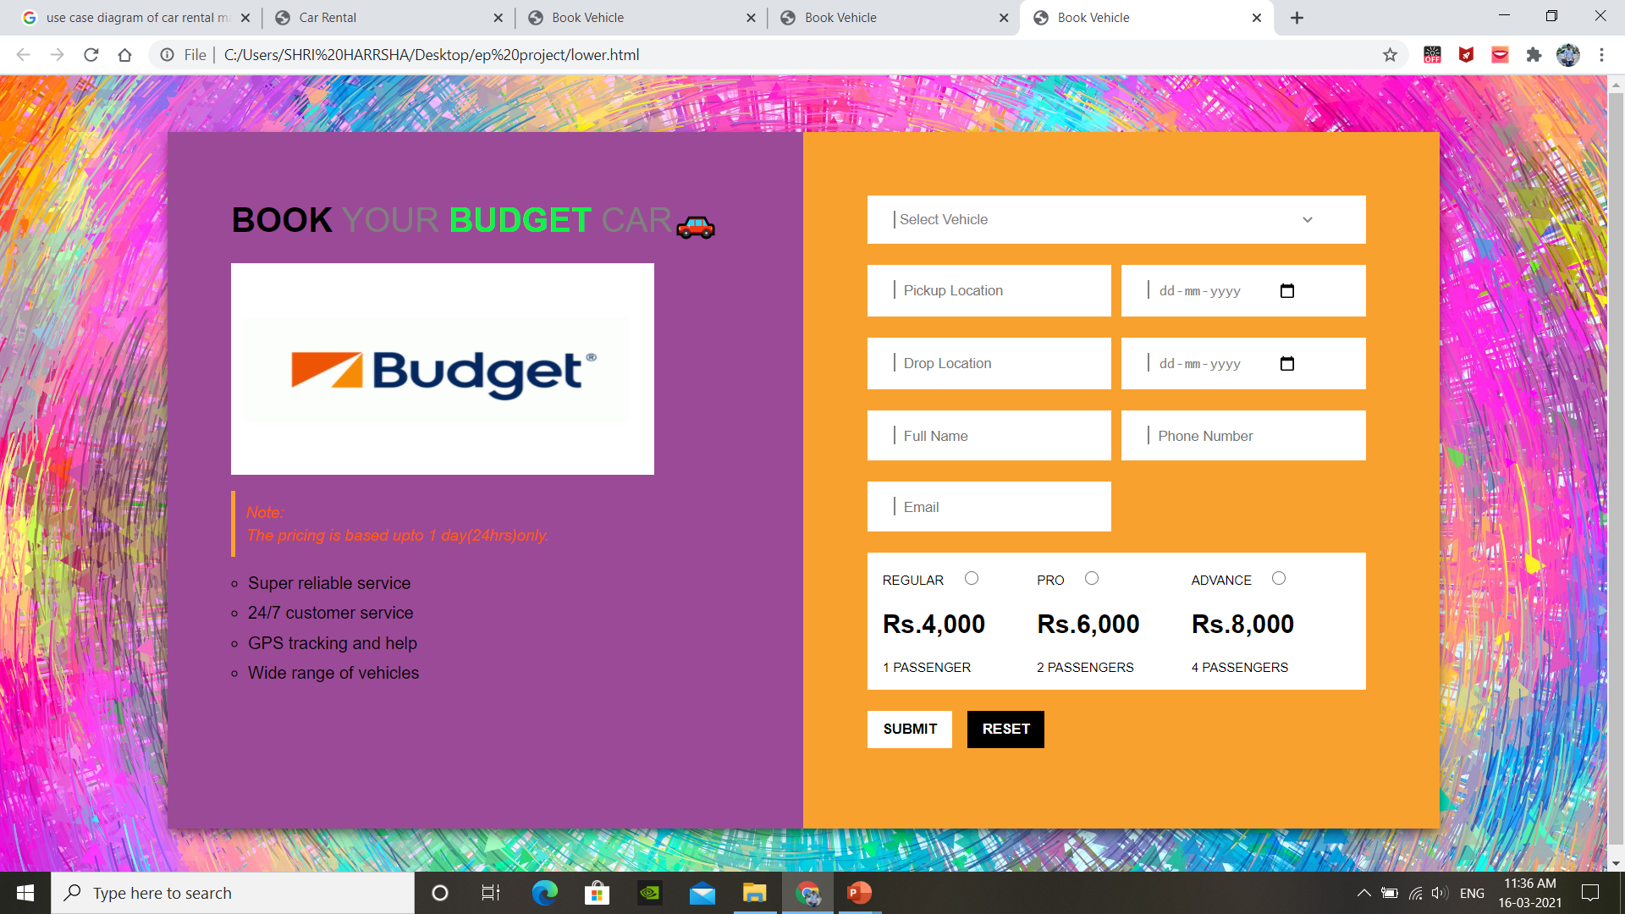

Slide 18
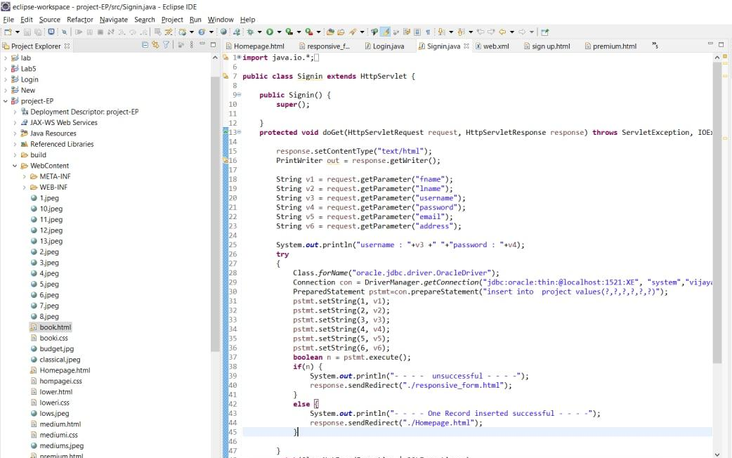
CODE

Slide 19
